Slide 1

PROJECT NAME :Complaint Redressal System
Developed BY Manoj Kumar K

Slide 2
Github link
https://github.com/Mskmanojkumar/E-Com_Sporty_Shoes

Slide 3
Overview
ABC Telecom Ltd. is one of India’s major telecommunication service providers offering landline, mobile phone and Fiber optic broadband services across the country. Their customer services group is interested in providing a set of customer redressal services through the development of a new application using the state-of-art technologies such as Spring-boot for the development of java-based services, and UI using Angular and integrate them suitably, so that all the necessary services are taken care of through this application. They want to have an online complaint management system where the customers can raise complaints regarding their landlines and broadband services..

Slide 4




Flow Chart
Start
A

Slide 5



Admin can create a new manager ,customer, engineer
Admin can manage all ticket can review
Admin can manage Role List

Slide 6




Customer Role
Customer can create a new Compline and Feedback
Customer can manage all ticket can review and FeedBack
Customer can Edit Ticket Details

Slide 7



C
Manager Role
Manager can assign a Ticket to Engineer
Manager can manage all ticket can review
Manager can add Comment on ticket

Slide 8



Engineer Role
Engineer Role
Engineer can Review and manage the ticket
Engineer can Escalate Ticket
Engineer can Resolve the issue

Slide 9
Documentation
Tools and Programming Language used in this Project
Angular
Git hub
Maven

Slide 10
Documentation
Tools and Programming Language used in this Project
JSON
HTML,CSS & JS
Docker

Slide 11
Documentation
Tools and Programming Language used in this Project
MySQL
Vs. Code
eclipse

Slide 12

Sprint Planning
Task Name | Start Date | End Date | Estimated Points | Pending | Completed | Status | PRIORITY
UI Screens and Login Screen | 12-Dec-21 | 15-Dec-21 | 10 points |  | 10 points | Completed | MEDIUM
Admin Activities through UI | 15-Dec-21 | 18-Dec-21 | 10 points |  | 10 points | Completed | HIGH
Manager Activities through UI | 18-Dec-21 | 23-Dec-21 | 10 points |  | 10 points | Completed | MEDIUM
Engineers Activities through UI | 23-Oct-21 | 28-Oct-21 | 10 points |  | 10 points | Completed | HIGH
Customer Activities through UI | 1-Jan-22 | 5-Jan-22 | 7 points |  | 7 points | Completed | HIGH
Integration and testing | 6-Jan-22 | 9-Jan-22 | 8 points |  | 8 points | Completed | MEDIUM

Slide 13

Core Concept and algorithm
lombok
JPA
Bootstrap
Form Module
Java Script
DevTools
Spring Boot

Slide 14
How to execute
Run Home.java Program file Location (\manoj\src)

Slide 15
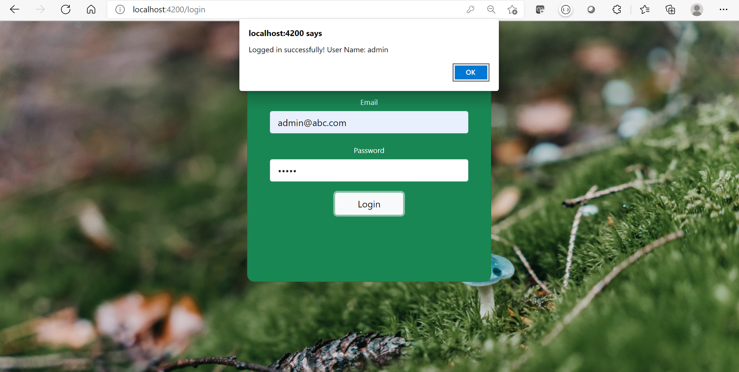
Sample Output 1

Slide 16
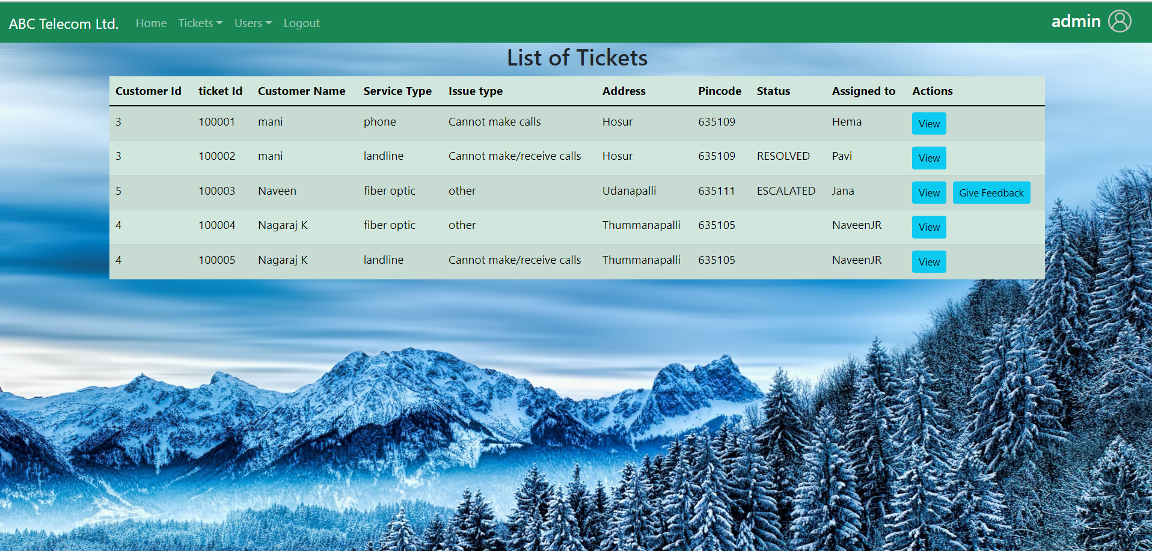
Sample Output 2

Slide 17
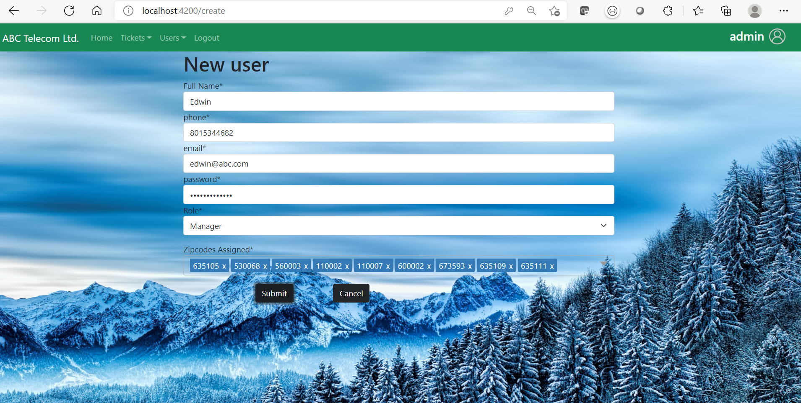
Sample Output 3

Slide 18
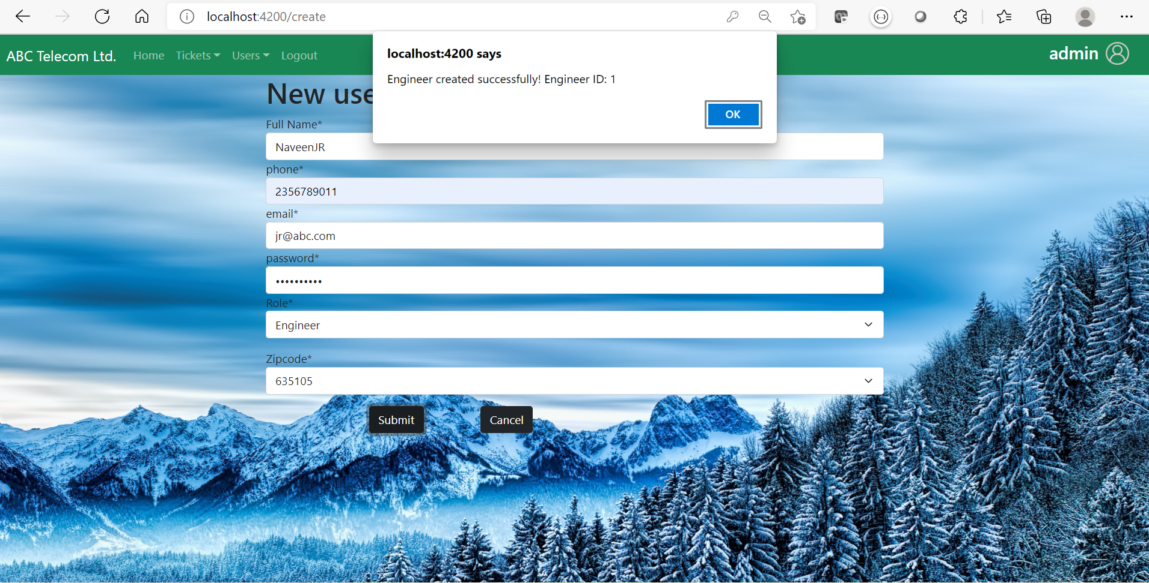
Sample Output 4

Slide 19
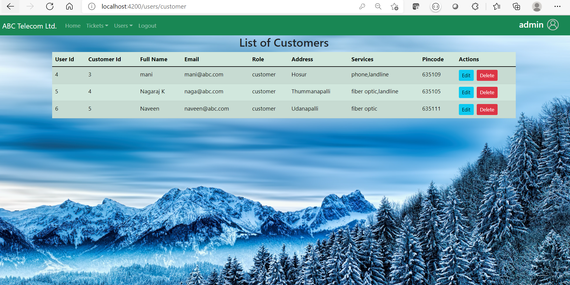
Sample Output 5

Slide 20
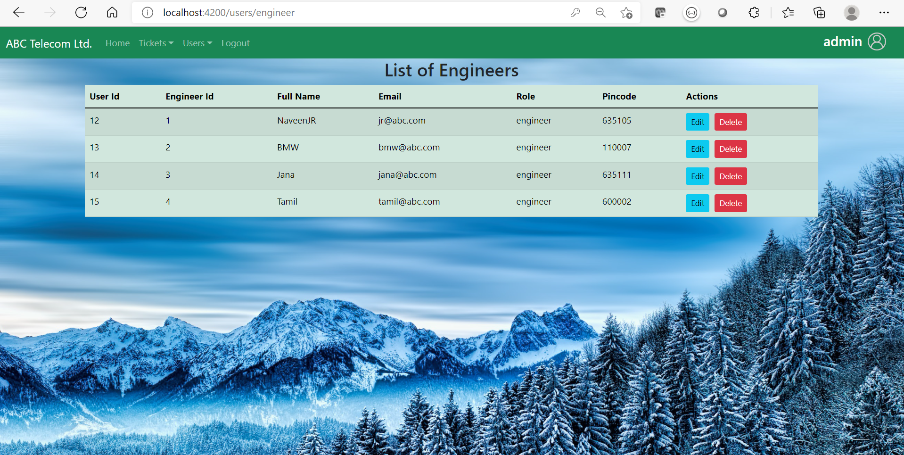
Sample Output 6

Slide 21
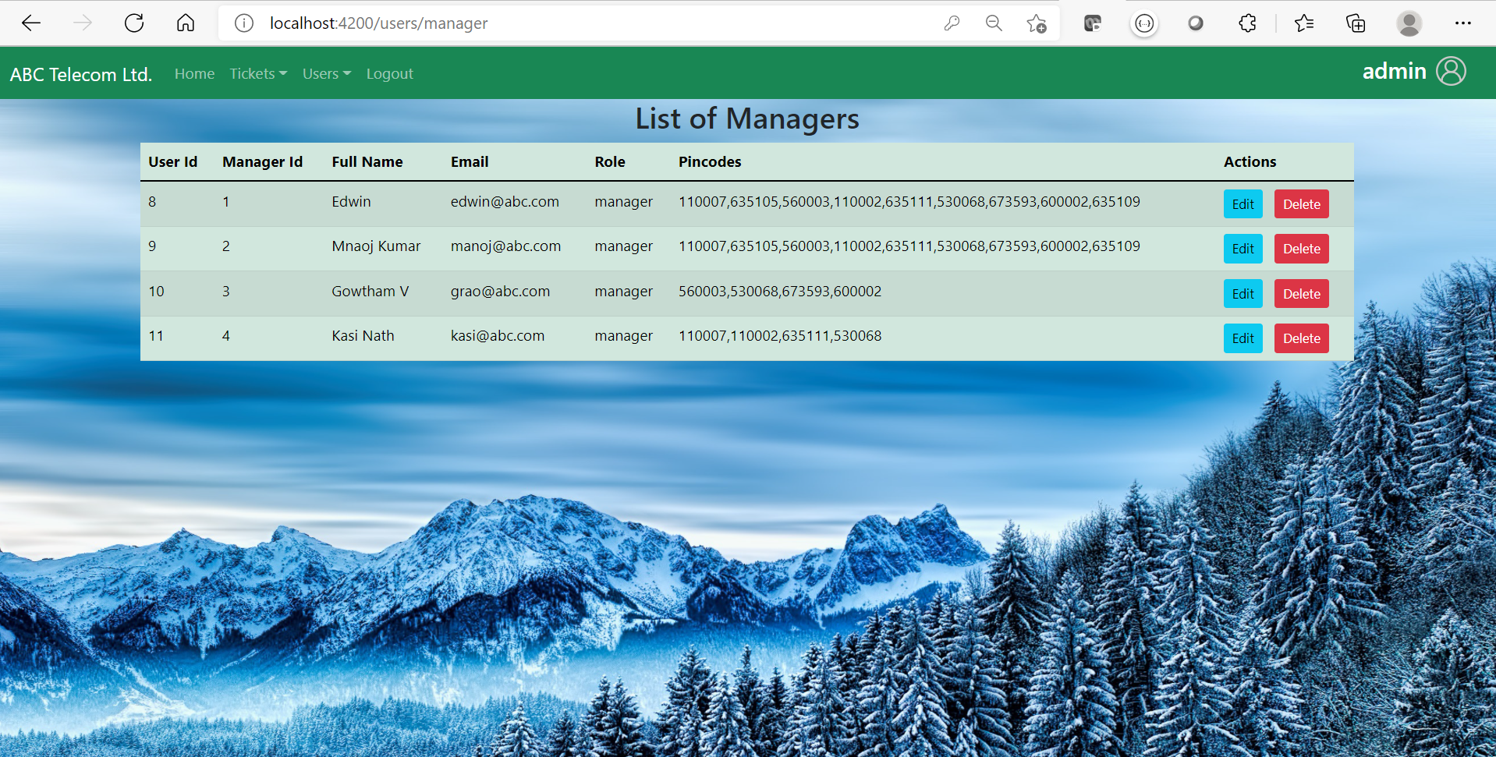
Sample Output 7

Slide 22
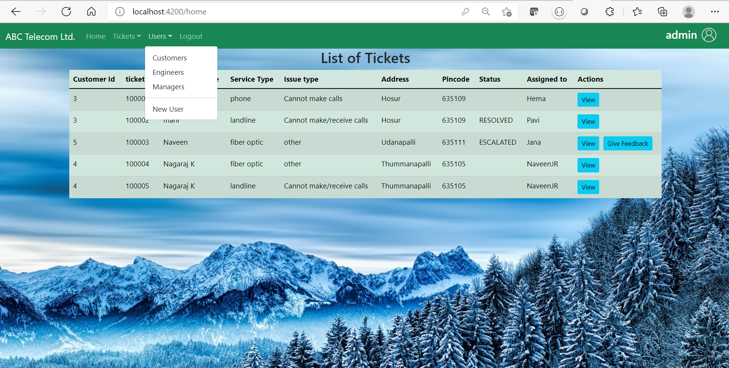
Sample Output 8

Slide 23
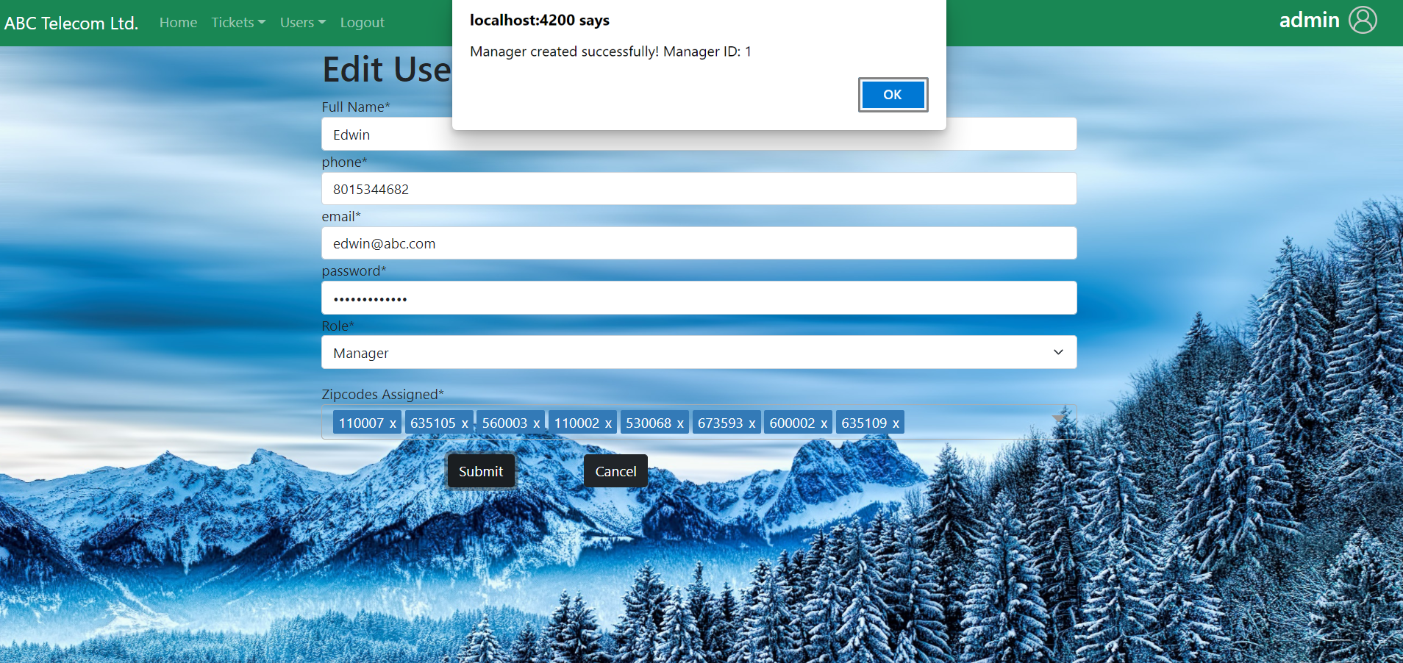
Sample Output 9

Slide 24
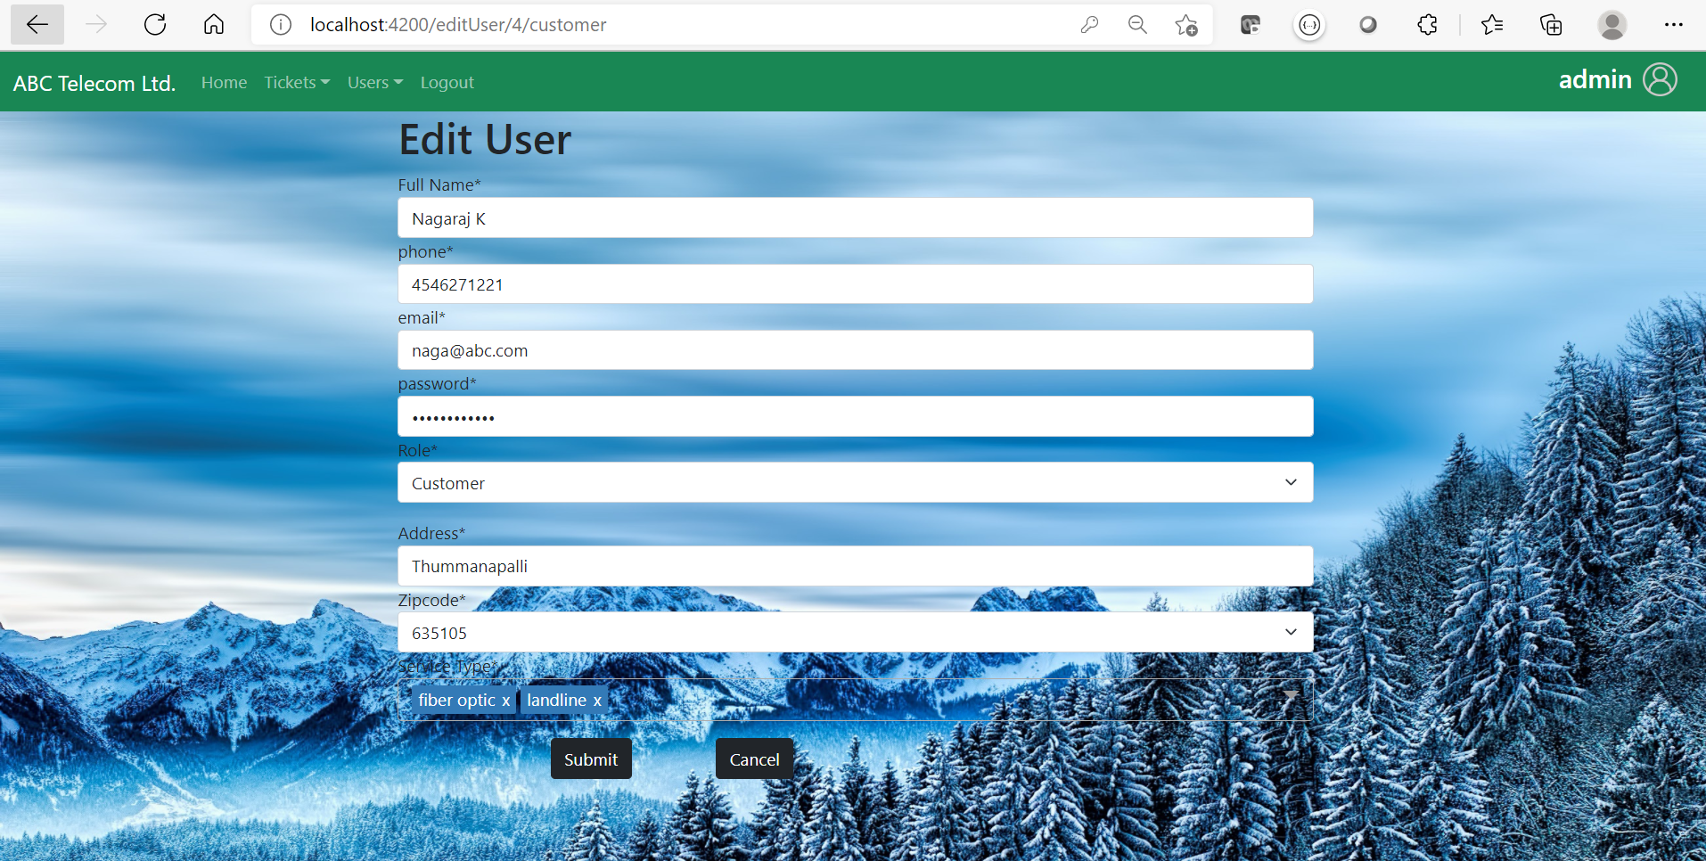
Sample Output 10

Slide 25
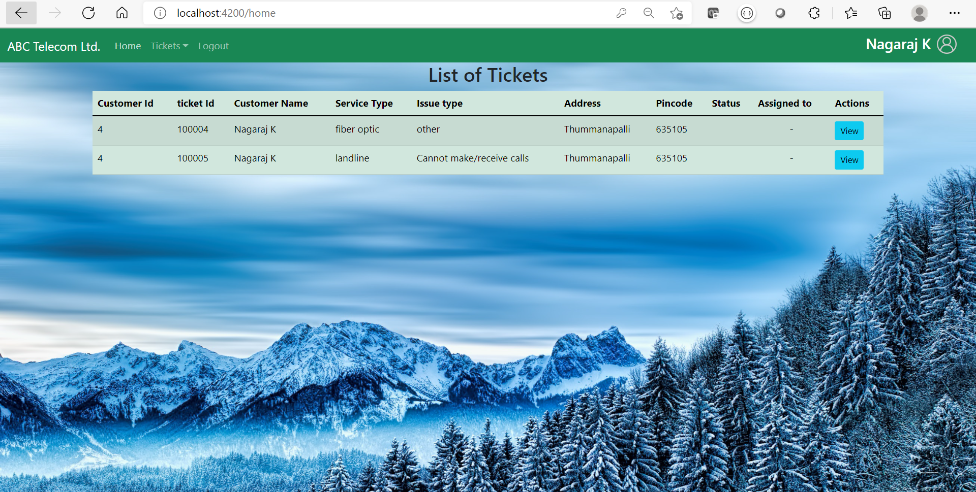
Sample Output 11

Slide 26
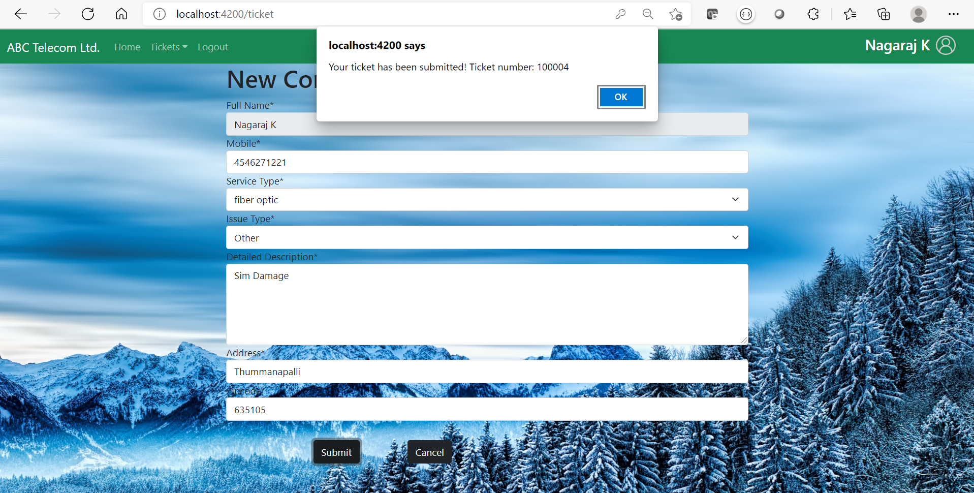
Sample Output 12

Slide 27
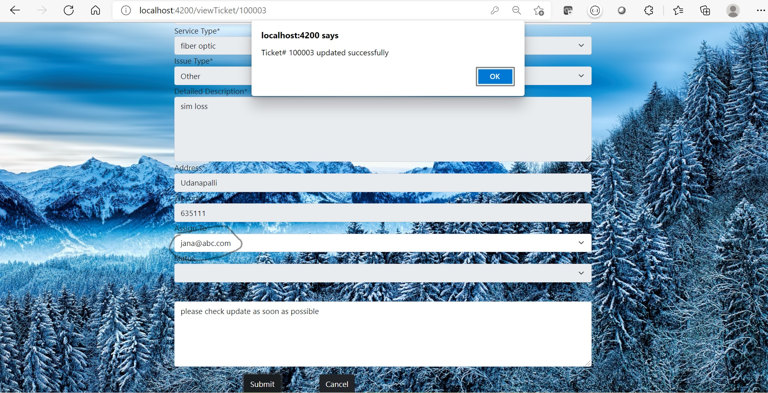
Sample Output 13

Slide 28
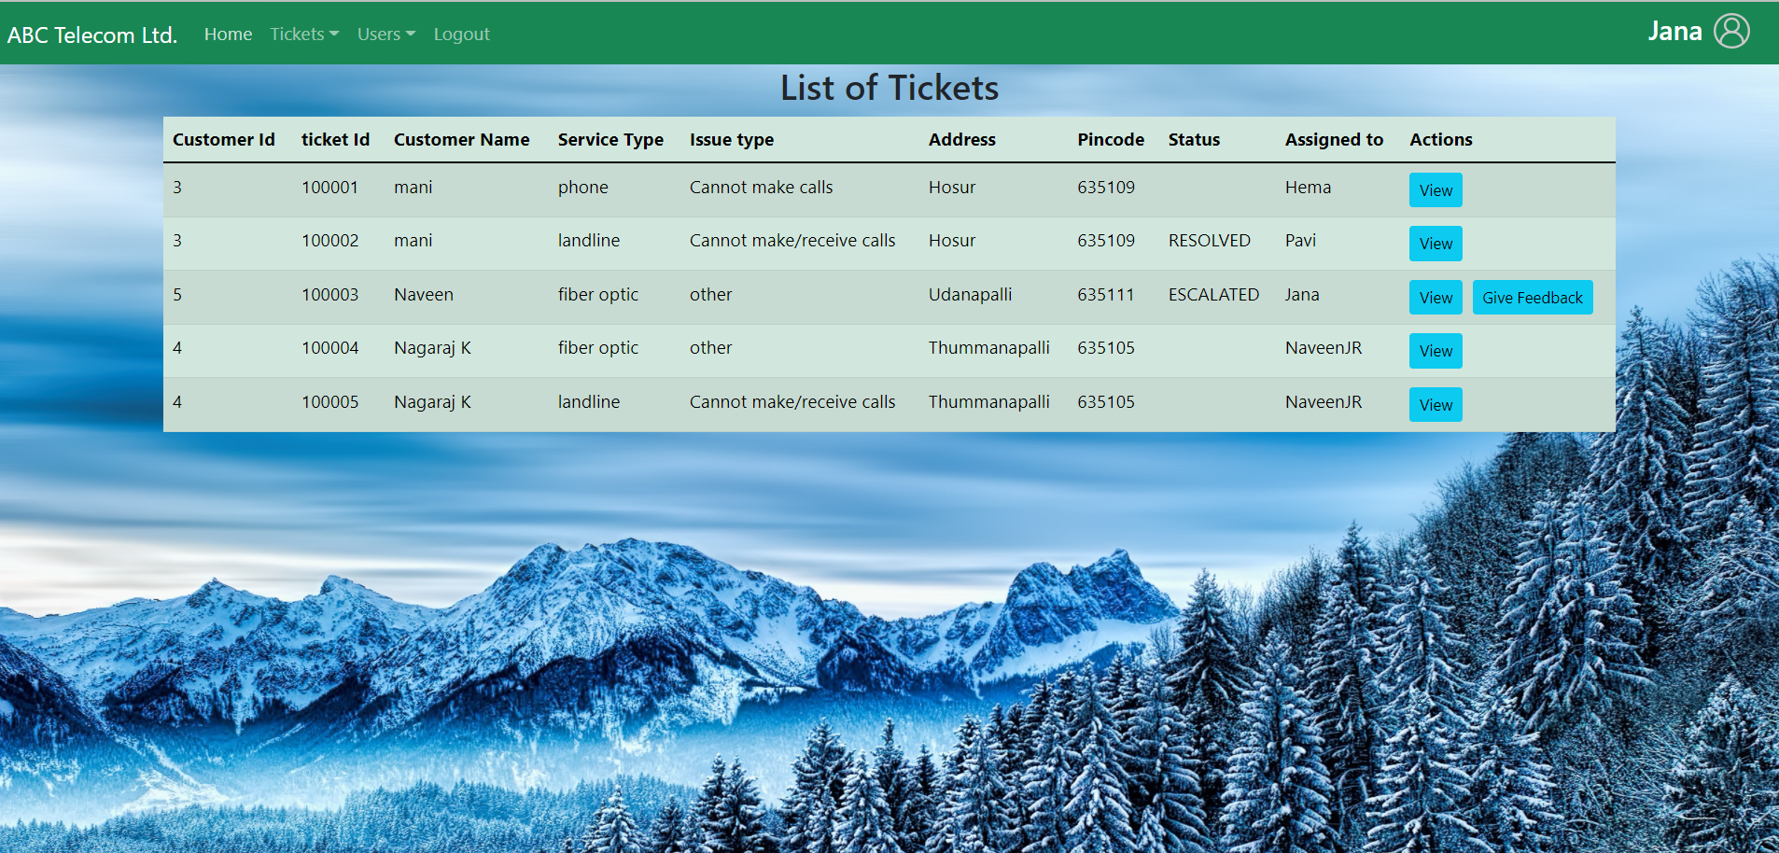
Sample Output 14

Slide 29
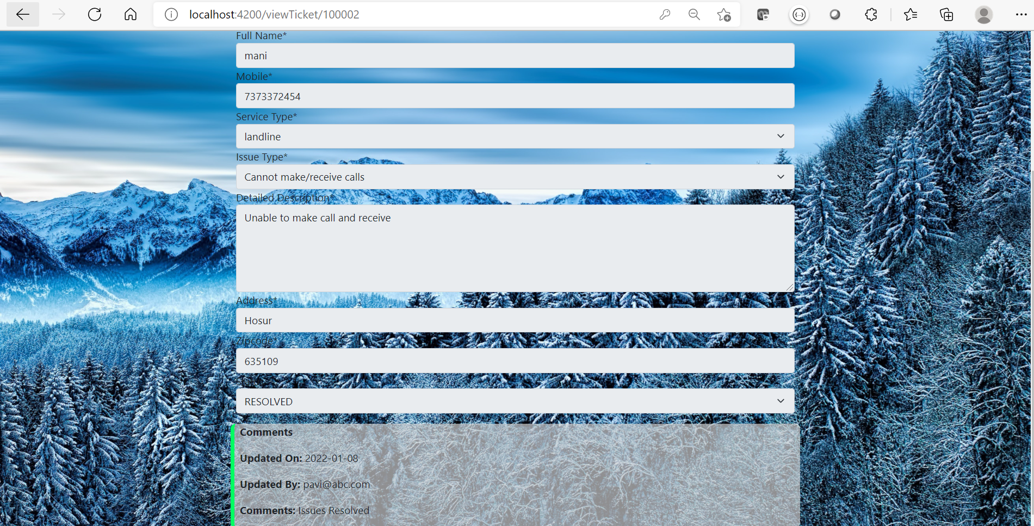
Sample Output 15

Slide 30
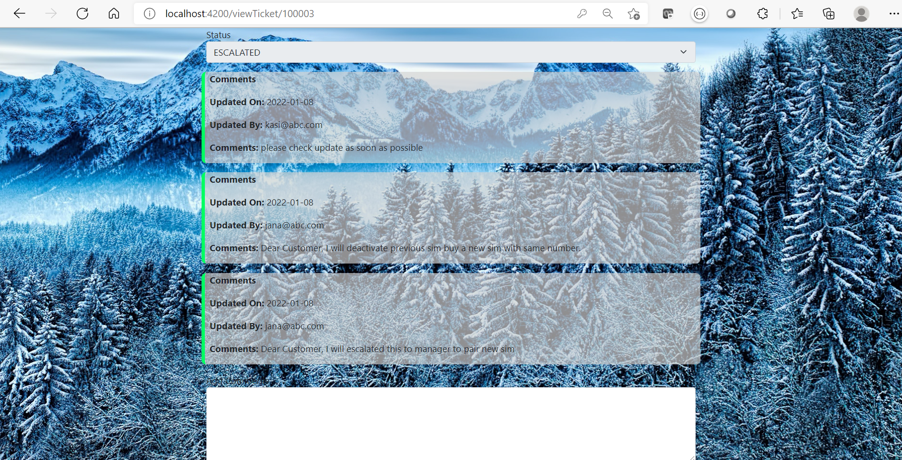
Sample Output 16

Slide 31
Sample Output 17

Slide 32
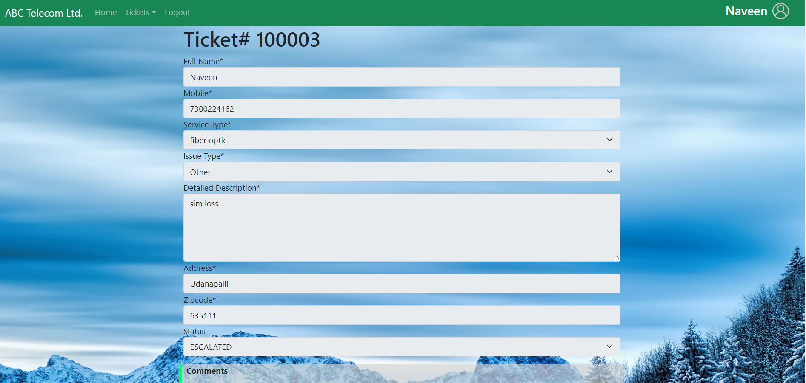
Sample Output 18

Slide 33
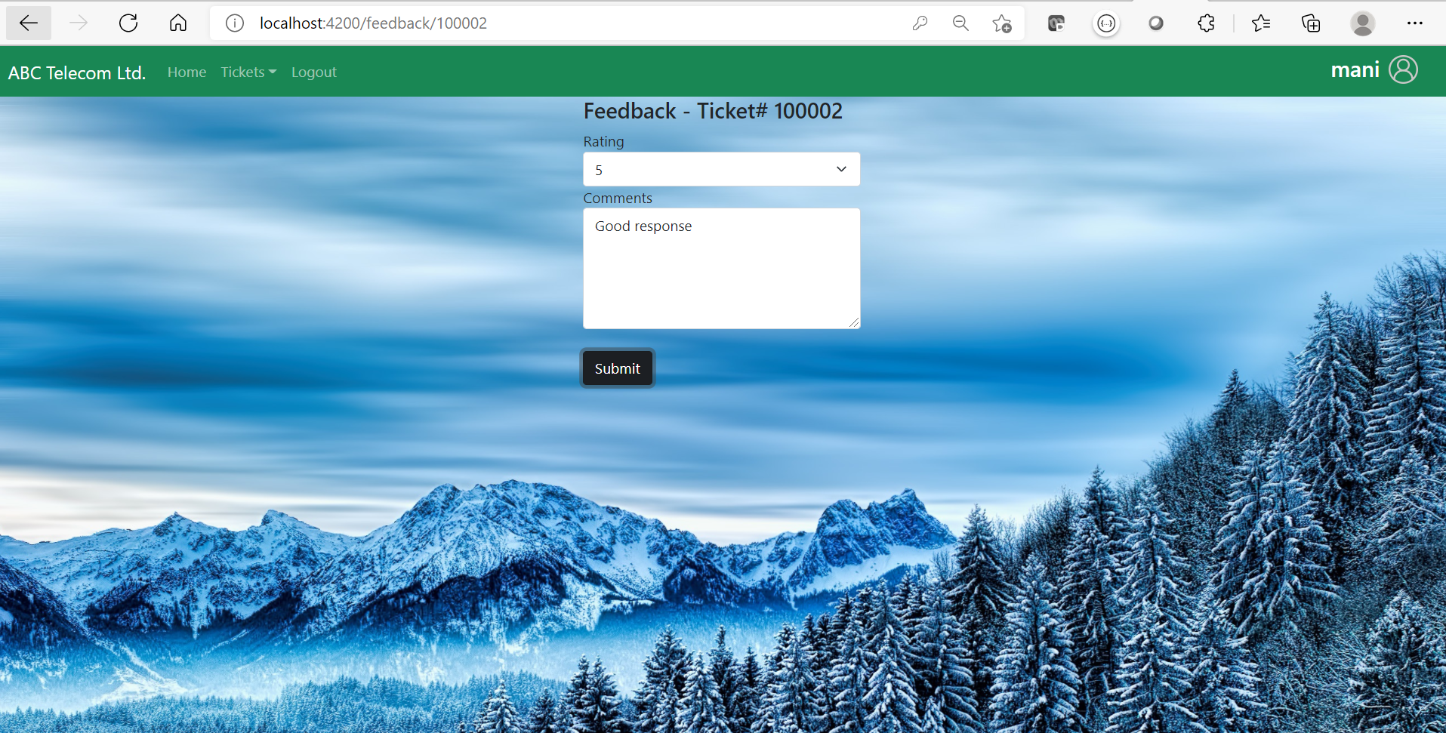
Sample Output 19

Slide 34

Thank You
Name : Manoj Kumar k
Phone no: 8667695691
manojkumar720066@Gmail.com

